Slide 1
Guerrilla advertising
Guessing the context of a text

Slide 2

Ad 1
Center for sleep disorders - agnesian.com

Slide 4
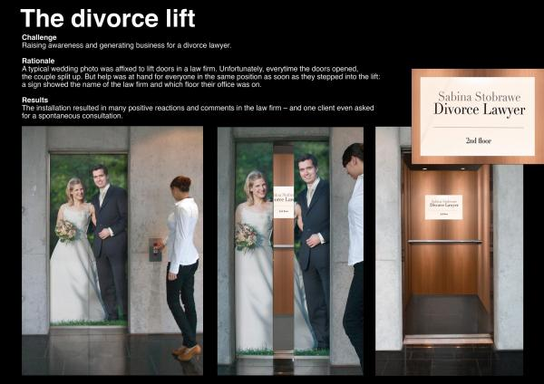
Ad 2
Sabina Stobrawe
Divorce Lawyer
2nd floor

Slide 6

Ad 3
Air pollution kills 60,000 people a year
NRDC.org

Slide 8
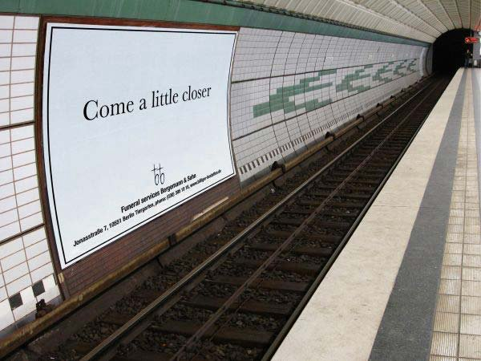
Ad 4
Come a little closer
Funeral services Bergmann & Sohn

Slide 10

Ad 5
Victims are people just like you and me
acat.ch

Slide 12
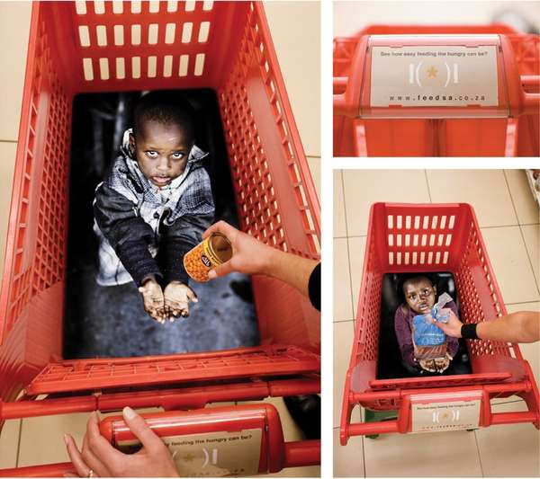
Ad 6

Slide 14
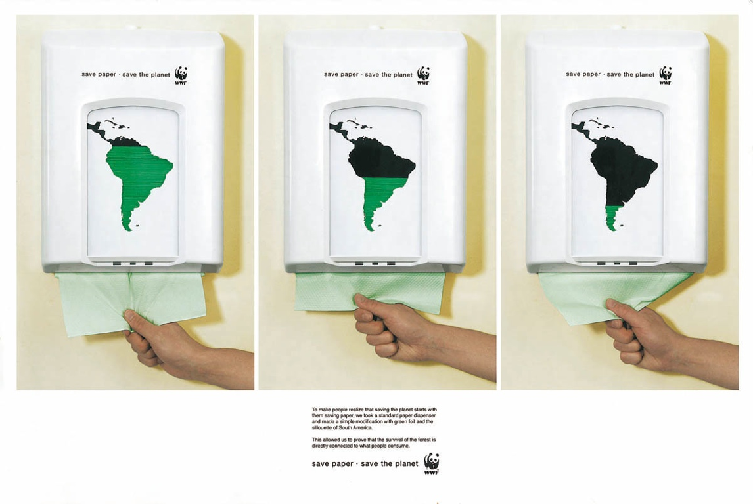
Ad 7
save paper - save the planet - WWF

Slide 16
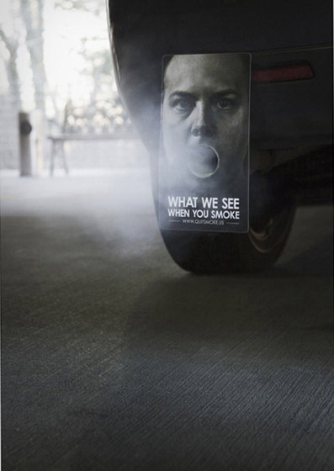
Ad 8
What we see when you smoke
www.quitsmoke.us

Slide 18
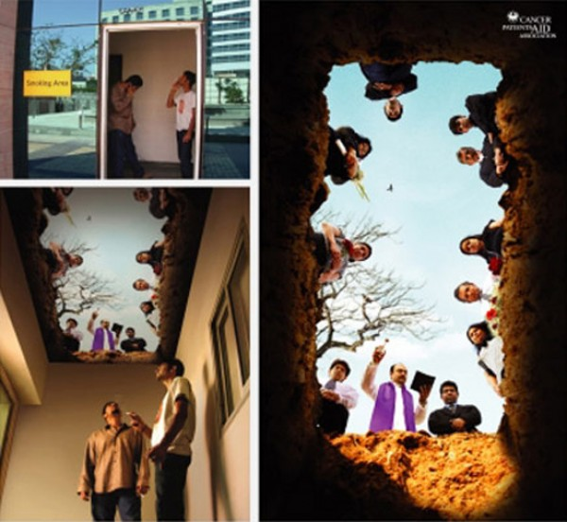
Ad 9

Slide 20
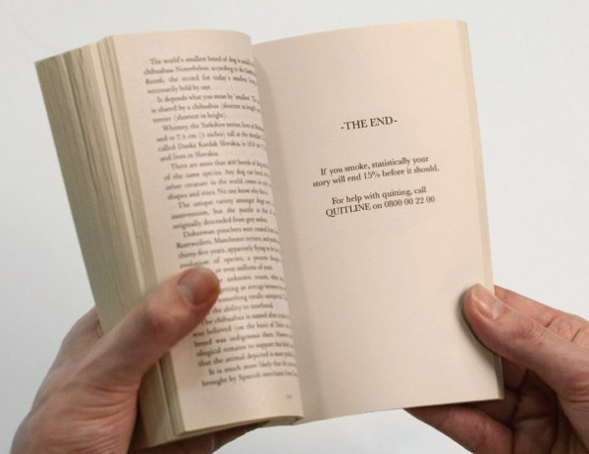
Ad 10
If you smoke, statistically your story will end 15% before it should.
For help with quitting call QUITLINE on 0800 002200

